Slide 1
Teaching Experience: Logic and Formal Methods with Coq
Martin Henz and Aquinas Hobor
School of Computing
National University of Singapore

Slide 2

WARNING

Slide 3
WARNING
YOU ARE ABOUT TO HEAR THE LEAST TECHNICAL TALK AT CPP / APLAS 2011

Slide 4
Introductory Logic (At NUS SoC: CS3234 & CS5209)
Propositional Logic
Predicate Logic
Induction
Modal Logic
Hoare Logic

Slide 5
Why is teaching logic hard?

Slide 6
Why is teaching logic hard?
What do the students say?

Slide 7

Why is teaching logic hard?
What do the students say?
Hard and very abstract

Slide 8
Why is teaching logic hard?
What do the students say?
Hard and very abstract
Dry and boring

Slide 9
Why is teaching logic hard?
What do the students say?
Hard and very abstract
Dry and boring
Removed from applications

Slide 10
What can we do?
What about introducing tool support?

Slide 11
What can we do?
What about introducing tool support?
How can a tool help address some of our problems?

Slide 12

“Hard and very abstract”
A partial win
Students often do not know when a proof is correct – tools help with this problem a lot
On the other hand, topic is still abstract
Also, the students now have to learn how to use the tool – makes their job harder

Slide 13
“Dry and boring”
A major win
Students in computer science enjoy using computers!
Some tools can be a lot of fun to use
Building [Coq] scripts is surprisingly addictive, in a videogame kind of way… [Xavier Leroy, 2005]

Slide 14
“Removed from applications”
A partial win
Students appreciate getting hands on a tool
We can bring up success stories for that tool
But we have found that it is not enough – we adjust by trying to bring up other example applications as we go through the curriculum

Slide 15
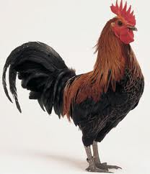
Selecting Coq
There are lots of tools out there: SAT solvers, model checkers, proof assistants, program verifiers, …
There is a cost to learn each tool
Breadth vs. Depth tradeoff
Coq is useful for almost the entire course

Slide 16
Integrating Coq into the Curriculum
See our paper!
We have also produced a (very much in progress, alpha) series of lecture notes (~80 pages) on the basic topics we cover: www.comp.nus.edu.sg/~henz/cs3234
For the rest of this talk I am going to cover a few highlights, lowlights, and options we have explored.

Slide 17
Topic 1: Aristotelian (Term) Logic
Start with something that may be more familiar: syllogisms
Syntax vs. semantics, proof theory (natural deduction), semantic arguments (models)
Introduce Coq
With Notation you can write things like, All Greeks are humans. in Coq!

Slide 18
Topic 1: Aristotelian (Term) Logic
Semantics is naive set theory (Venn diagrams)
Good puzzles from Lewis Carroll:

Slide 19
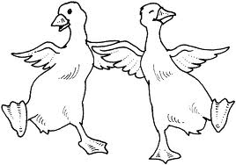
Topic 1: Aristotelian (Term) Logic
Semantics is naive set theory (Venn diagrams)
Good puzzles from Lewis Carroll:
No ducks waltz.

Slide 20


Topic 1: Aristotelian (Term) Logic
Semantics is naive set theory (Venn diagrams)
Good puzzles from Lewis Carroll:
No ducks waltz.
No officers ever decline to waltz.
½

Slide 21
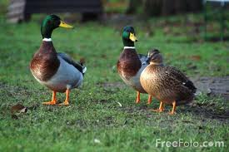
Topic 1: Aristotelian (Term) Logic
Semantics is naive set theory (Venn diagrams)
Good puzzles from Lewis Carroll:
No ducks waltz.
No officers ever decline to waltz.
All my poultry are ducks.
½

Slide 22
Topic 1: Aristotelian (Term) Logic
Semantics is naive set theory (Venn diagrams)
Good puzzles from Lewis Carroll:
No ducks waltz.
No officers ever decline to waltz.
All my poultry are ducks.
It should be obvious that:
No officers are my poultry.
2

Slide 23
Topic 2: Object vs. Meta logic
We find it useful to cover propositional logic in Coq twice
We first cover it encoded as a datatype
Inductive Formula : Type :=
| AndForm : Formula -> Formula -> Formula
…
We provide a module signature with the axioms of propositional logic

Slide 24
Topic 2: Object vs. Meta logic
We have them prove simple facts via those axioms (in a module functor).
We point out that the tactics they have been using (e.g., split) are similar to axioms in the module signature (e.g., conj_i)
We find this approach helps students understand the distinction between object logic and meta logic.

Slide 25
Topic 3: Explaining Coq
Teaching with Coq becomes a bit entwined with teaching Coq.
To a typical third-year undergraduate student, Coq is remarkably close to voodoo.
Poor error messages don’t help matters…
This tends to cause undue hacking, etc.

Slide 26
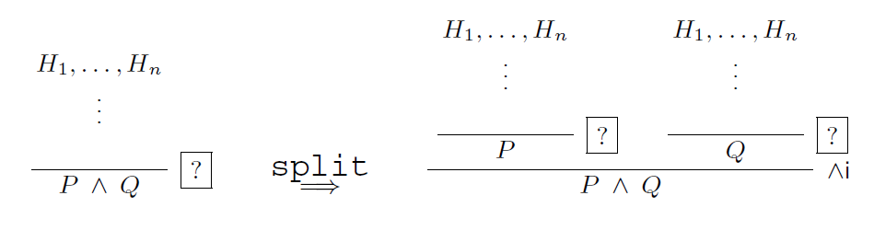
Topic 3: Explaining Coq
We have found the following form of diagram useful when explaining tactics to students:

Slide 27
Topic 4: Predicate Logic
It is extremely useful to demonstrate binder management via Coq.
That is, use “rewrite” tactic to show Coq handles variable capture, etc.
Paper proofs improved once they could try such things out in the theorem prover.

Slide 28
Topic 5: Induction
Students usually have a very hard time understanding induction on paper.
Coq handles induction beautifully.
We saw a significant increase in comprehension vs. prior years in understanding induction.
Their paper proofs improved a lot as a result!

Slide 29
Topic 6: Modal Logic
Coq does not directly support natural deduction proofs in modal logic.
Best [de Wind ‘01]. Still not much fun.
Semantic style: use modal operators to express theorems, but often have to unfold definitions to prove them.

Slide 30
Topic 6: Modal Logic
We did get some benefits from using Coq.
We covered a kind of higher-order multimodal logic.
One benefit was that we were able to investigate correspondence theory in Coq.

Slide 31
Topic 7: Hoare Logic
Concrete program verification in Coq is extremely painful.
Maybe better tactics would help, or some other clever tricks… not sure.
We had to assign virtually all of the concrete verifications by hand.
Instructors used Coq to debug Huth & Ryan.
Maybe it would be valuable to add a second tool.

Slide 32
Topic 7: Hoare Logic
We had more success on the semantic side of Hoare logic – usually ignored in courses.
Used a “dynamic logic” approach to define the Hoare tuple via modal logic.
If you set things up just right, the students can prove the soundness of a simple Hoare logic (both partial and total) in Coq!

Slide 33
Topic 8: Odds and Ends
Custom tactics: we tried it, most of the time we avoid it now.
Homework: we try to assign some of the same problems both in Coq and on Paper.
Applications: we discuss several (sports tournament scheduling, network security analysis, etc.).

Slide 34
Topic 8: Odds and Ends
Takes significant experimentation to find the right definitions.
Running this course took a lot of time. Hopefully as the notes become more polished this will be reduced.
Cheating: it’s an issue. Our final exams are done in the lab and are 40% in Coq.

Slide 35
A final quote
“I would like to thank you for the Automated Theorem Prover (Coq) you taught in CS5209 course. It makes life easy while trying to prove theorem as compared to paper part. In addition to this it saves life of student in Final exam. In the beginning for the course I hated Coq a lot, but slowly I start liking it as I understood the way tactic works and how to use them. Now it has become most favorite and interesting part of mine in this course.” (2009/2010)

